Slide 1

January 2023: Wave 21 Global Consumer Barometer
Cost of living: Testing the resilience of the global consumer in 2023

Slide 2

Toluna - Helping you Make the Right Decisions,
Faster.
Technology
Cutting-edge research capabilities through our Toluna Start platform and ongoing tech innovation.
Expertise and Service
We incorporate our best thinking into our platform and can offer custom consultancy service when needed.
People
The world’s largest social voting community. More than 40 million strong. 70+ markets.
Notes:
About Toluna slide – circle and 3 core component slides
Narrative to include:
Segway into about Toluna: before I begin today’s session a bit about Toluna/Harris and why we are sharing today’s presentation
Run through who we are what we do as an organisation
Purpose / Tech / People / Quality / Scale
Toluna only
e.g. We’re the home of agile research, combining the fusion of technology, robust methodology and the reach of a global panel engaging with 40m respondents in 70+ markets.​ We are the creators of Toluna Start, the leading end-to-end consumer intelligence platform enabling our clients to ask what they want, when they want, to who they want, AND to have access to quality data in real-time.
Enhanced value is delivered to our clients through our combination of our technology and our people, and we have a truly flexible service model to suit all client project needs.
Toluna & Harris
e.g For those not familiar with Harris, we’re part of the Toluna group, the home of agile research. Together we offer a team of research experts who understand the sector, combined with agile research tools and technology – providing clients the ability to ask what they want, when they want, to who they want. Clients can tap our global panel of 40m+ respondents in 70+ markets – and have quality data in real time.​

Slide 3



Market | Completed Interviews
UK | 1023
France | 1010
Germany | 1004
Italy | 1011
Spain | 1018
US | 1007
Brazil | 1015
Australia | 1017
Singapore | 500
Japan | 1005
Korea | 1005
China | 1027
UAE | 507
New Zealand | 510
Mexico | 1007
Saudi Arabia | 508
India | 503
Thailand | 502
WAVE 21: 18 Markets, 15,000+ interviews
Fieldwork took place between 6th – 13th January 2023
Data has been weighted by age, gender, and region to be Census representative in all markets (except UAE, where regions are not weighted).
In France, data is also weighted to reflect social grade.
India and Thailand are new markets added for Wave 21
- GLOBAL BAROMETER: Wave 21

Slide 4

Summary
- GLOBAL BAROMETER: Wave 21

Slide 5
Core topics covered today
Consumer Sentiment
Festive Season – the fallout
Cost of Living
Impact on Consumer Health & Well-Being
Brand Purpose & ESG

Slide 6

Consumer Sentiment
Life Satisfaction Continues to Improve
Expectations for Improvement by End of 2023
+6pts compared to January 2022
35% believe their personal financial situation will improve in the next three months
This rises to 44% who believe things will improve by the end of 2023
Consumer Confidence in Spending is Low
Only 27% globally are confident spending money (+3pts since January 2022)
- GLOBAL BAROMETER: Wave 21

Slide 7
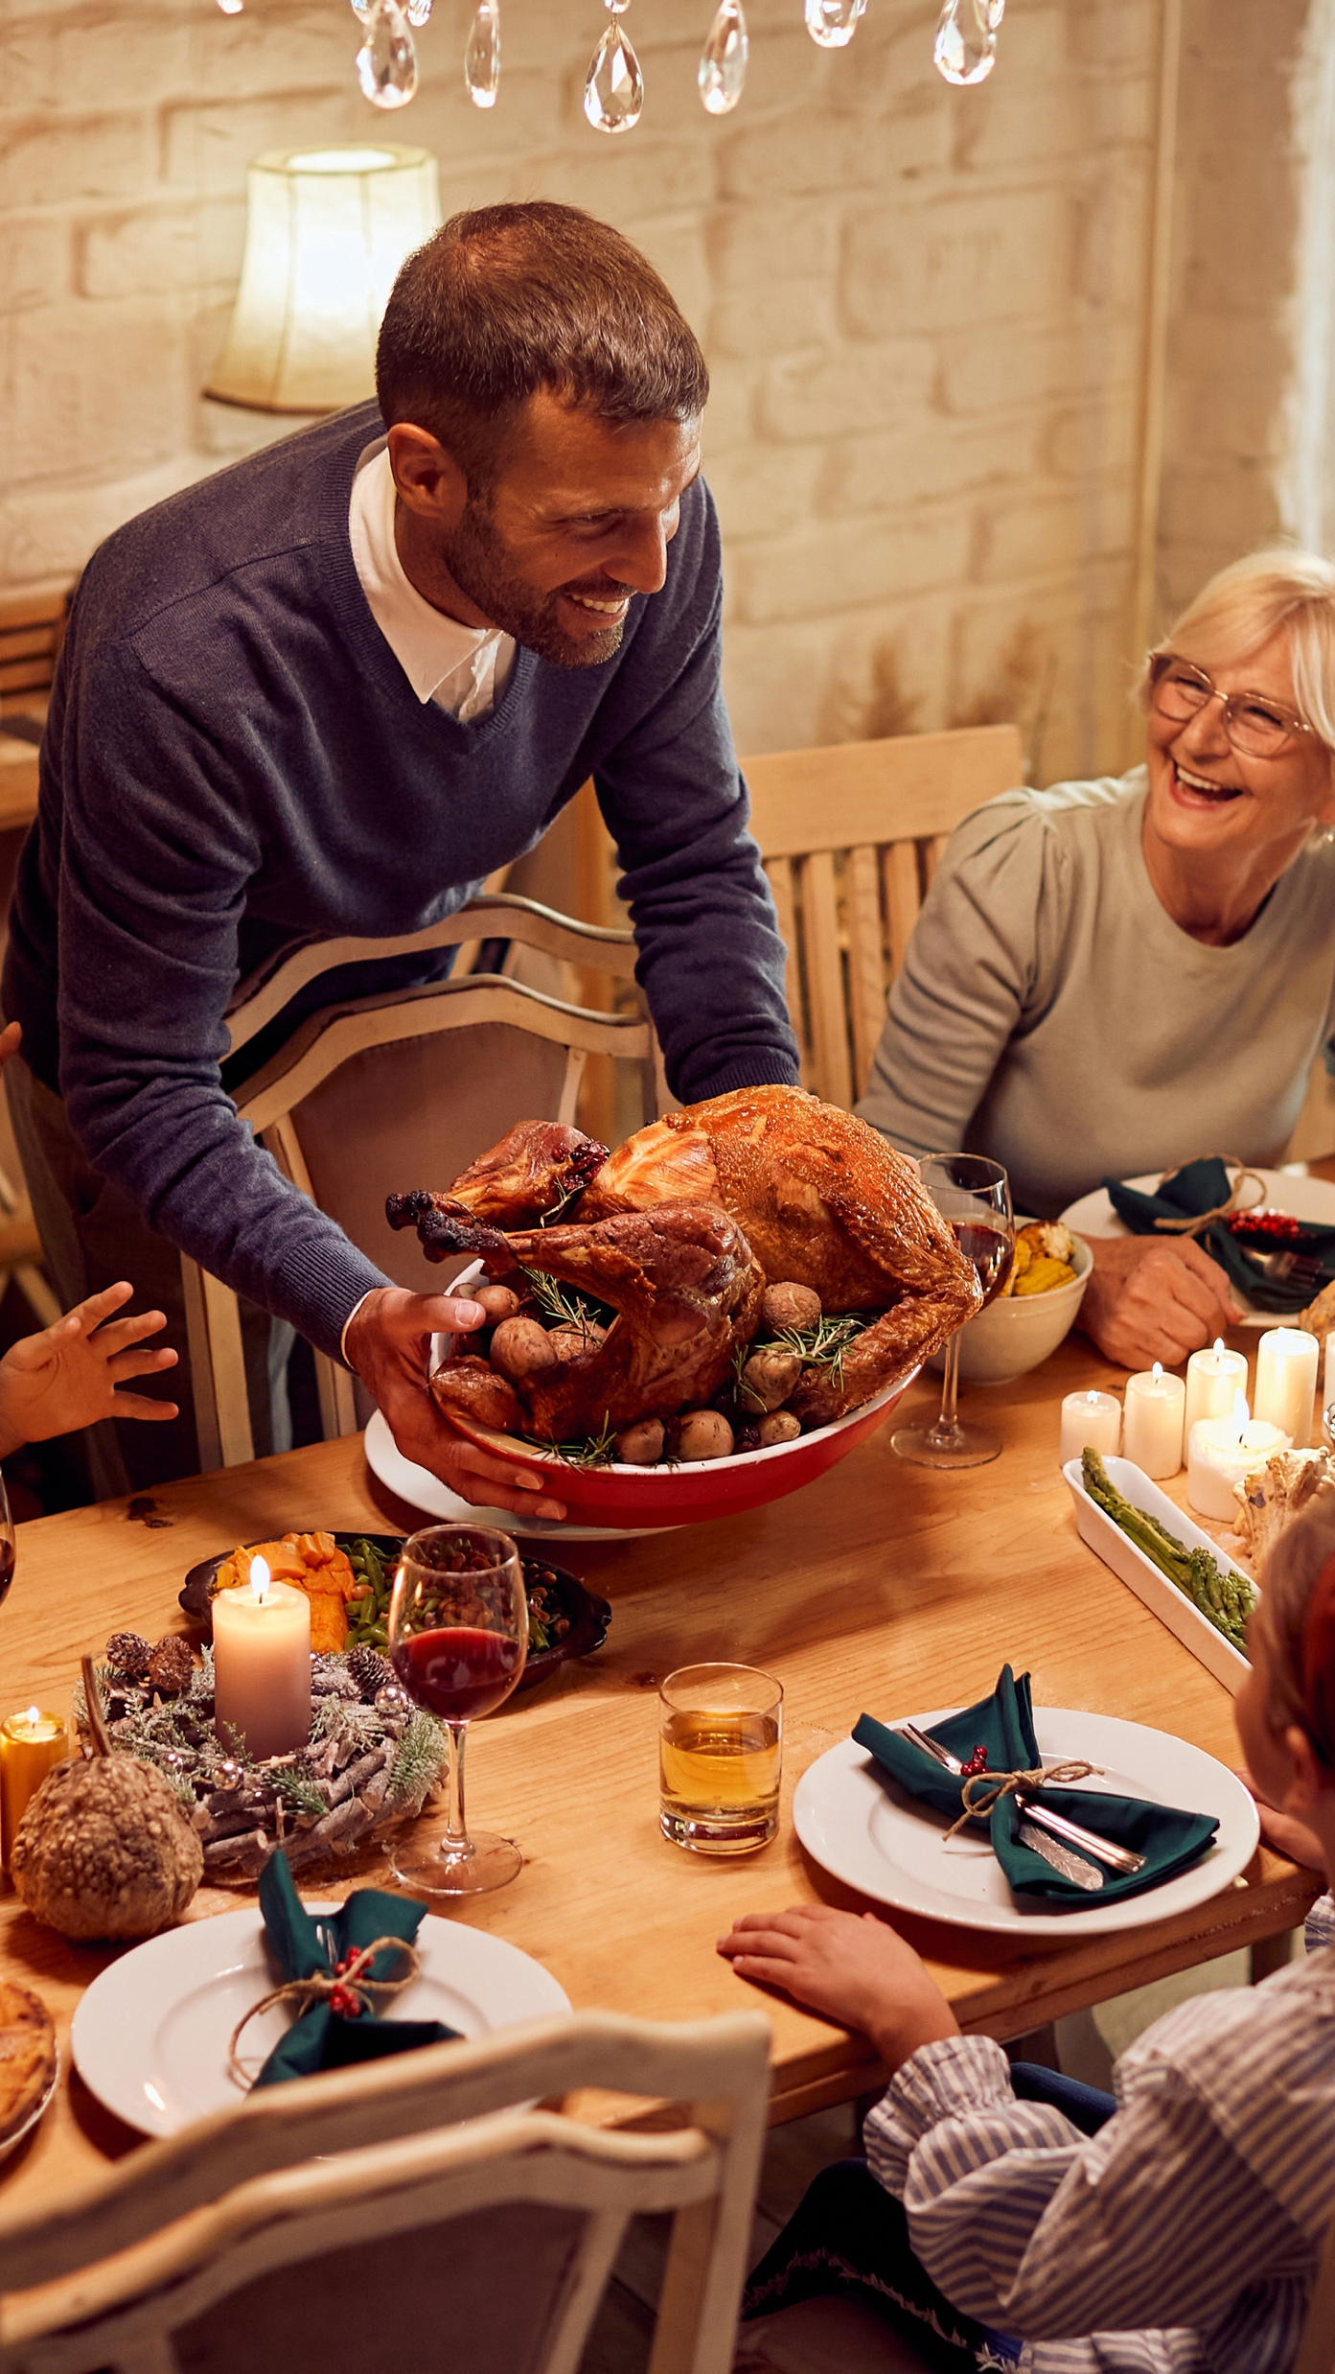

Holiday Season
Consumers saved more and earlier than normal because of the rising cost of living:
53% tried to spend less than normal/previous years
40% started saving earlier
Consumers were also worried about availability of items:
32% bought earlier this year compared to normal/previous years due to concerns about stock shortages
tried to save over the holidays given the economic uncertainty
59%
were very concerned about being able to afford the recent holiday season
31%
of people are very concerned about paying off debts from their spending during the recent holiday season
25%
- GLOBAL BAROMETER: Wave 21

Slide 8

Universal Impact of
Rising Cost-of-Living
Savvy Shopping:
Consumers are most likely to reduce unnecessary purchases (52%), compare prices (37%) or visit more stores in search of value (31%)
Leisure Spend Cutbacks:
    Consumers are most likely to cut back spending on social activities to help manage finances:
      32% Eating out
      22% ordering a takeout
      20% Going to bar/pubs
      20% Going on holiday abroad
agree that rising energy and living costs are impacting their spending
69%
60%
are putting off big life expenditures until the economic / financial climate is more stable
- GLOBAL BAROMETER: Wave 21

Slide 9

Direct Impact on Consumer Health & Well-Being
The effect of the cost-of-living crisis:
34% of consumers are experiencing higher levels of stress due to the higher cost of living.
50% agree that the rising cost of living is impacting their health and well-being
- GLOBAL BAROMETER: Wave 21

Slide 10

Consumer
Confidence
- GLOBAL BAROMETER: Wave 21

Slide 11


Globally, ‘Life Satisfaction’ has improved 6pts compared to this time last year…
SENTIMENT TRACKER
47%
of global consumers report feeling very satisfied with their life over the last two weeks (+6pts vs January 2022)
60%
in the Americas, led by Mexico (72%)
46%
in APAC & MENA
68% in UAE (biggest increase +13%)
65% in Saudi Arabia
39%
in Europe (lowest in the UK at 34%)
- GLOBAL BAROMETER: Wave 21
Notes:
Biggest increases:
UAE: +13% (55% -> 68%)
Brazil: +10% (50% -> 60%)
Biggest decreases:
China: -6% (68% -> 63%)
Korea: -1% (28% -> 27%)
Regions:
EU: +5% (34% -> 39%)
Americas: +7% (53% -> 60%)
APAC/MENA: +7% (40% -> 46%) – (Jan 22 not include KSA, IN, TH)
UK: +3% (31% -> 34%)
Spain: +5% (36% -> 41%)
Germany: +7% (39% -> 46%)
Italy: +7% (29% -> 36%)
France: +2% (37% -> 39%)

Slide 12
SENTIMENT TRACKER
Optimism is high in some regions, but lowest in Europe
44%
Of global consumers report feeling very optimistic about the future (+5pts vs January 2022, +13pts since Jan 21)
30%
In Europe
40% in Germany (up 4pts)
22% in France (down 2pts)
UK flat at 27%
46%
In APAC & MENA
74% in UAE
70% in India
64%
In the Americas +6% higher in LATAM than the USA (47%)
- GLOBAL BAROMETER: Wave 21
Notes:
Biggest increases:
UAE: +7% (67% -> 74%)
USA: +7% (39% -> 47%)
Biggest decreases:
Korea: -3% (25% -> 22%)
China: -2% (69% -> 67%)
France: -2% (24% -> 22%)
Regions:
EU: +1% (29% -> 30%)
Americas: +6% (58% -> 64%)
APAC/MENA: +8% (38% -> 46%) – (Jan 22 not include KSA, IN, TH)
UK: 0% (27% -> 27%)
Spain: +2% (33% -> 35%)
Germany: +4% (36% -> 40%)
Italy: 0% (28% -> 27%)
France: -2% (24% -> 22%)

Slide 13
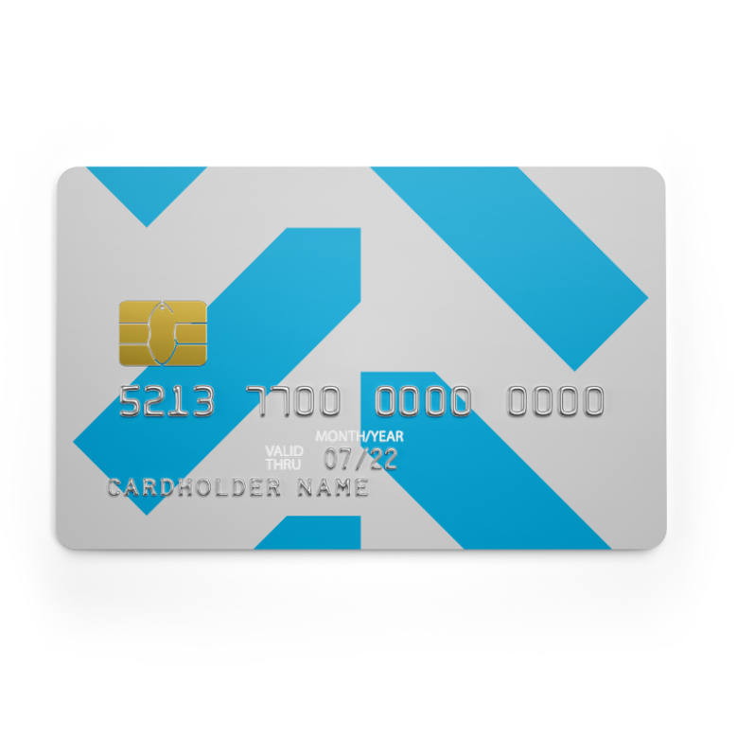
SENTIMENT TRACKER
However, consumers are still cautious with their finances
JUST
27%
Of global consumers say they are very confident spending money over the coming months given the cost of living
35% in the Americas
16% in Europe & the UK (UK is at current low point now vs Sept 21 high of 31%)
WAS
24%
+3pp since January 2022
WAS
18%
In Jan 2021
Notes:
UK is in current low point now (-15% versus sep 21 high)

Slide 14
SENTIMENT TRACKER
41%
35% of global consumers believe their personal financial situation will get better in the next three months, rising to 44% who believe this will be the case by the end of 2023.
UK: 37%
Of global consumers are very concerned about their personal financial security given current global and economic circumstances
Financial situation in the next 3 months
Financial situation by the end of 2023
UK: 15%
UK: 22%
Net:
35%
Net:
44%
Net:
30%
Net:
32%
UK: 57%
UK: 56%
- GLOBAL BAROMETER: Wave 21

Slide 15
Consumers are increasingly concerned about their personal financial security, yet confidence in spending is slowly rising
Concern regarding 2nd COVID wave
Concern regarding 2nd COVID wave
Energy crisis concern
Concern in the UK was lower than Global throughout pandemic but has risen since cost-of-living crisis.
Confidence in spending in UK has remained lower than global throughout and declined further in the past year
- GLOBAL BAROMETER: Wave 21

Slide 16
Consumers are increasingly concerned about their personal financial security, yet confidence in spending is slowly rising
Concern regarding 2nd COVID wave
Concern regarding 2nd COVID wave
Energy crisis concern
- GLOBAL BAROMETER: Wave 21

Slide 17
SENTIMENT TRACKER
Wave21
35%
Of global consumers either feel worried about their employment, are in reduced employment, or have become unemployed since the pandemic
This is 30% in the UK
20% worried about employment
6% in reduced employment
4% unemployed
- GLOBAL BAROMETER: Wave 21

Slide 18
People feel less worried about their employment since the pandemic, but the proportion remains sizeable
SENTIMENT TRACKER
Concern regarding 2nd COVID wave
Concern regarding 2nd COVID wave
Energy crisis concern
- GLOBAL BAROMETER: Wave 21

Slide 19
Utility bills are seeing the sharpest expected increases
SENTIMENT TRACKER
Expect to Spend More
The top areas in which consumers expect to spend more money this year are:
UK
Wave 21: 70%
Wave 18: 60%
UK
Wave 21: 25%
Wave 18: 28%
Utility bills
UK
Wave 21: 16%
Wave 18: 15%
Vacations/holidays
UK
Wave 21: 20%
Wave 18: 22%
Healthcare
UK
Wave 21: 18%
Wave 18: 24%
- GLOBAL BAROMETER: Wave 21

Slide 20
Since the energy crisis, utility bills have seen the sharpest expected rise in spend
SENTIMENT TRACKER
Expect to Spend More
Concern regarding 2nd COVID wave
Energy crisis concern
- GLOBAL BAROMETER: Wave 21
Notes:
MQ8

Slide 21

The Holiday
Season

Slide 22

Consumers shopped earlier for the 2022 Holiday Season
THE HOLIDAY SEASON
32%
Bought earlier this year compared to normal/previous years due to concerns about stock shortages
30%
Shopped around to get the gift they wanted because items were not readily available
23%
Struggled to buy the gifts they wanted to this year due to stock issues
22%
Paid more to get the gift they wanted because items were not readily available

Slide 23

THE HOLIDAY SEASON
Most consumers made an effort to save for the holidays
59%
Of global consumers tried to save given economic uncertainty
(+1pp since Jan 22)
UK: 56%
28%
Were not concerned about spending/ spending more
(-4pp since Jan 22)
UK: 37%
Notes:
Add diff for UK? +7% and -6%

Slide 24
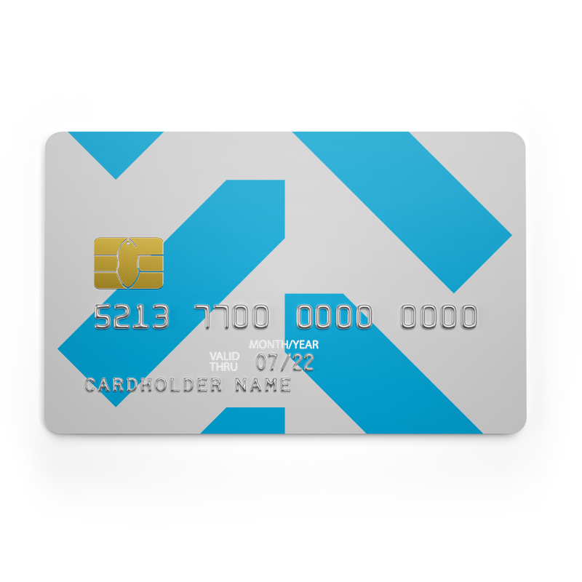
THE HOLIDAY SEASON
Globally 3 in 10 saved more this holiday season than previous years. 4 in 10 used credit to delay payment
31%
of people were very concerned about being able to afford the cost of the recent holiday season
UK: 30%
30%
Saved more for the holiday season than previous years
UK: 21%
43%
Used credit to delay payment and spread the cost over time to pay for their holiday season
UK: 38%

Slide 25
THE HOLIDAY SEASON
Globally, consumers paid for the holiday season in a similar way to last year, with a combination of credit and savings/current account
Payment for the holiday season

Slide 26

THE HOLIDAY SEASON
25%
Of global consumers are very concerned about paying off any debts from their spending during the recent holiday season
21% in the UK

Slide 27
53%
of global consumers tried to spend less than normal over the holiday season given the rising cost of living
52% in the UK
started saving earlier for the cost of the holiday season this year for the same reason
33% in the UK

Slide 28
Compared to a normal year, consumers were mostly likely to cut back on:
THE HOLIDAY SEASON
Spending over the holiday season
Presents/gifts
Top 2 Box
(A lot/a bit more)
Bottom 2 Box
(A lot/a bit less)
Pre-holiday festivities
Drinking alcohol in pubs/bars

Slide 29
Those who spent more on gifts in 2022 cited that items were more expensive—while those who spent less attributed it to the cost-of-living crisis.
GIFTING
21%
32%
Globally spent more on gifts this holiday season
Globally spent less on gifts this holiday season
Top 3 reasons for spending more on gifts in 2023
Top 3 reasons for spending less on gifts in 2023
N/A
Notes:
Weighted base less = 4678
Weighted base more = 2956

Slide 30

GIFTING
Impact of environmental and social issues when buying gifts:
Strongly agree/agree (T2B)
Were more concerned about sustainability/environmental issues when buying gifts in 2022
36%
Were more concerned about social/ethical responsibility when buying gifts in 2022
35%

Slide 31

The Impact of the
Rising Cost-of-Living

Slide 32
69%
86% In Thailand
73% In Saudi Arabia
77% In India
72% In Spain and UAE
74% In Singapore
69% In the UK
Of global consumers agree:
“The energy crisis and rising cost of living is impacting my spending plans.”
Since January 2022 (Wave 18), concerns around the energy crisis have notably increased

Slide 33

COST OF LIVING
Consumers plan to save money by reducing energy and water usage in the coming months
63%
41%
Turning the lights off whenever possible
(+5pp since last wave)
Taking shorter showers to reduce water usage
(no change since last wave)
39%
32%
Using eco/cold washes on washing machines or dishwashers
(+3pp since last wave)
Reducing the target temperature of heating
(+4pp since last wave)
26%
25%
Investing in smart solutions to reduce energy waste
(+1pp since last wave)
Programming laundry during low tariff hours
(no change since last wave)

Slide 34

60%
Of global consumers agree that now is not the time to spend on big-ticket items
63%
In the Americas, driven by Brazil (72%)
“I am putting off big life expenditures until the economic / financial climate is more stable.”
59%
In Europe, APAC, and MENA
62%
In the UK (-3pp since last wave)

Slide 35
COST OF LIVING
40%
Top areas consumers expect to spend less on over next 3 months
of global consumers expect to spend less on eating out over the next few months
Beyond eating/drinking out, clothes, holidays and electricals also appear to be hard-hit as the cost-of-living crisis continues

Slide 36

COST OF LIVING
84%
Of global consumers are experiencing price increases in fresh food
WAS
81%
In Wave 20

Slide 37

COST OF LIVING
Price increases on red meat are driving consumers to substitute with white meat, eggs, and fish
Red meat replacement
44% in Japan, New Zealand

Slide 38
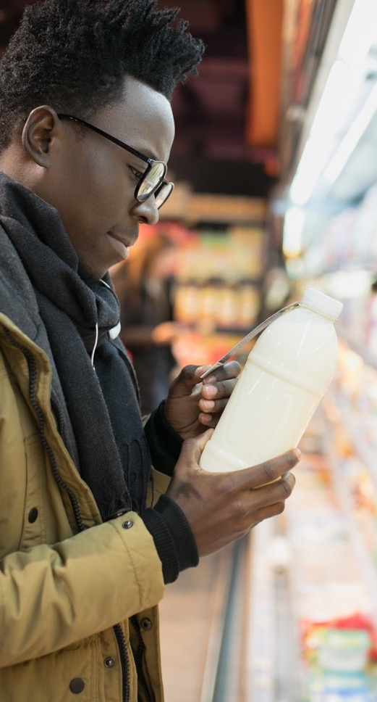
COST OF LIVING
In order to manage cost-of-living increases over the next three months, consumers are most likely to cut back on non-essential items
52%
37%
Reduce unnecessary purchases
(+7pp since last wave)
Compare prices
(online or offline)
(+6pp since last wave)
UK: 47% (-4pp since last wave)
UK: 28% (+4pp since last wave)
31%
28%
Visit more stores in search of value
(+1pp since last wave)
Change supermarkets to a cheaper alternative
(no change since last wave)
UK: 24% (no change since last wave)
UK: 27% (-4pp since last wave)
27%
25%
Shop more often to avoid waste and get the best deals
(no change since last wave)
Buy own-label products
(no change since last wave)
UK: 38% (-4pp since last wave)
UK: 20% (-1pp since last wave)

Slide 39
COST OF LIVING
Factors when choosing groceries products
3 in 4
global consumers report price as the most important factor when choosing groceries in the next 3 months.

Slide 40
COST OF LIVING
Global
Top 5 activities where consumers would NOT give up to save money
Cost-conscious consumers globally are least likely to give up phone contracts
UK
Cost-conscious consumers in the UK are least likely to give up phone contracts and TV subscriptions
Top 5 activities where consumers would NOT give up to save money

Slide 41

47% of global consumers will turn to family if they need financial help/support over the next few months
COST OF LIVING
UK: 36%
22%
of people would turn to a Banks / Building Society
UK: 20%
22%
Would ask a friend
UK: 17%
16%
Government / Benefit System
UK: 13%

Slide 42

Impact on Consumer Health & Well-Being
- GLOBAL BAROMETER: Wave 21

Slide 43
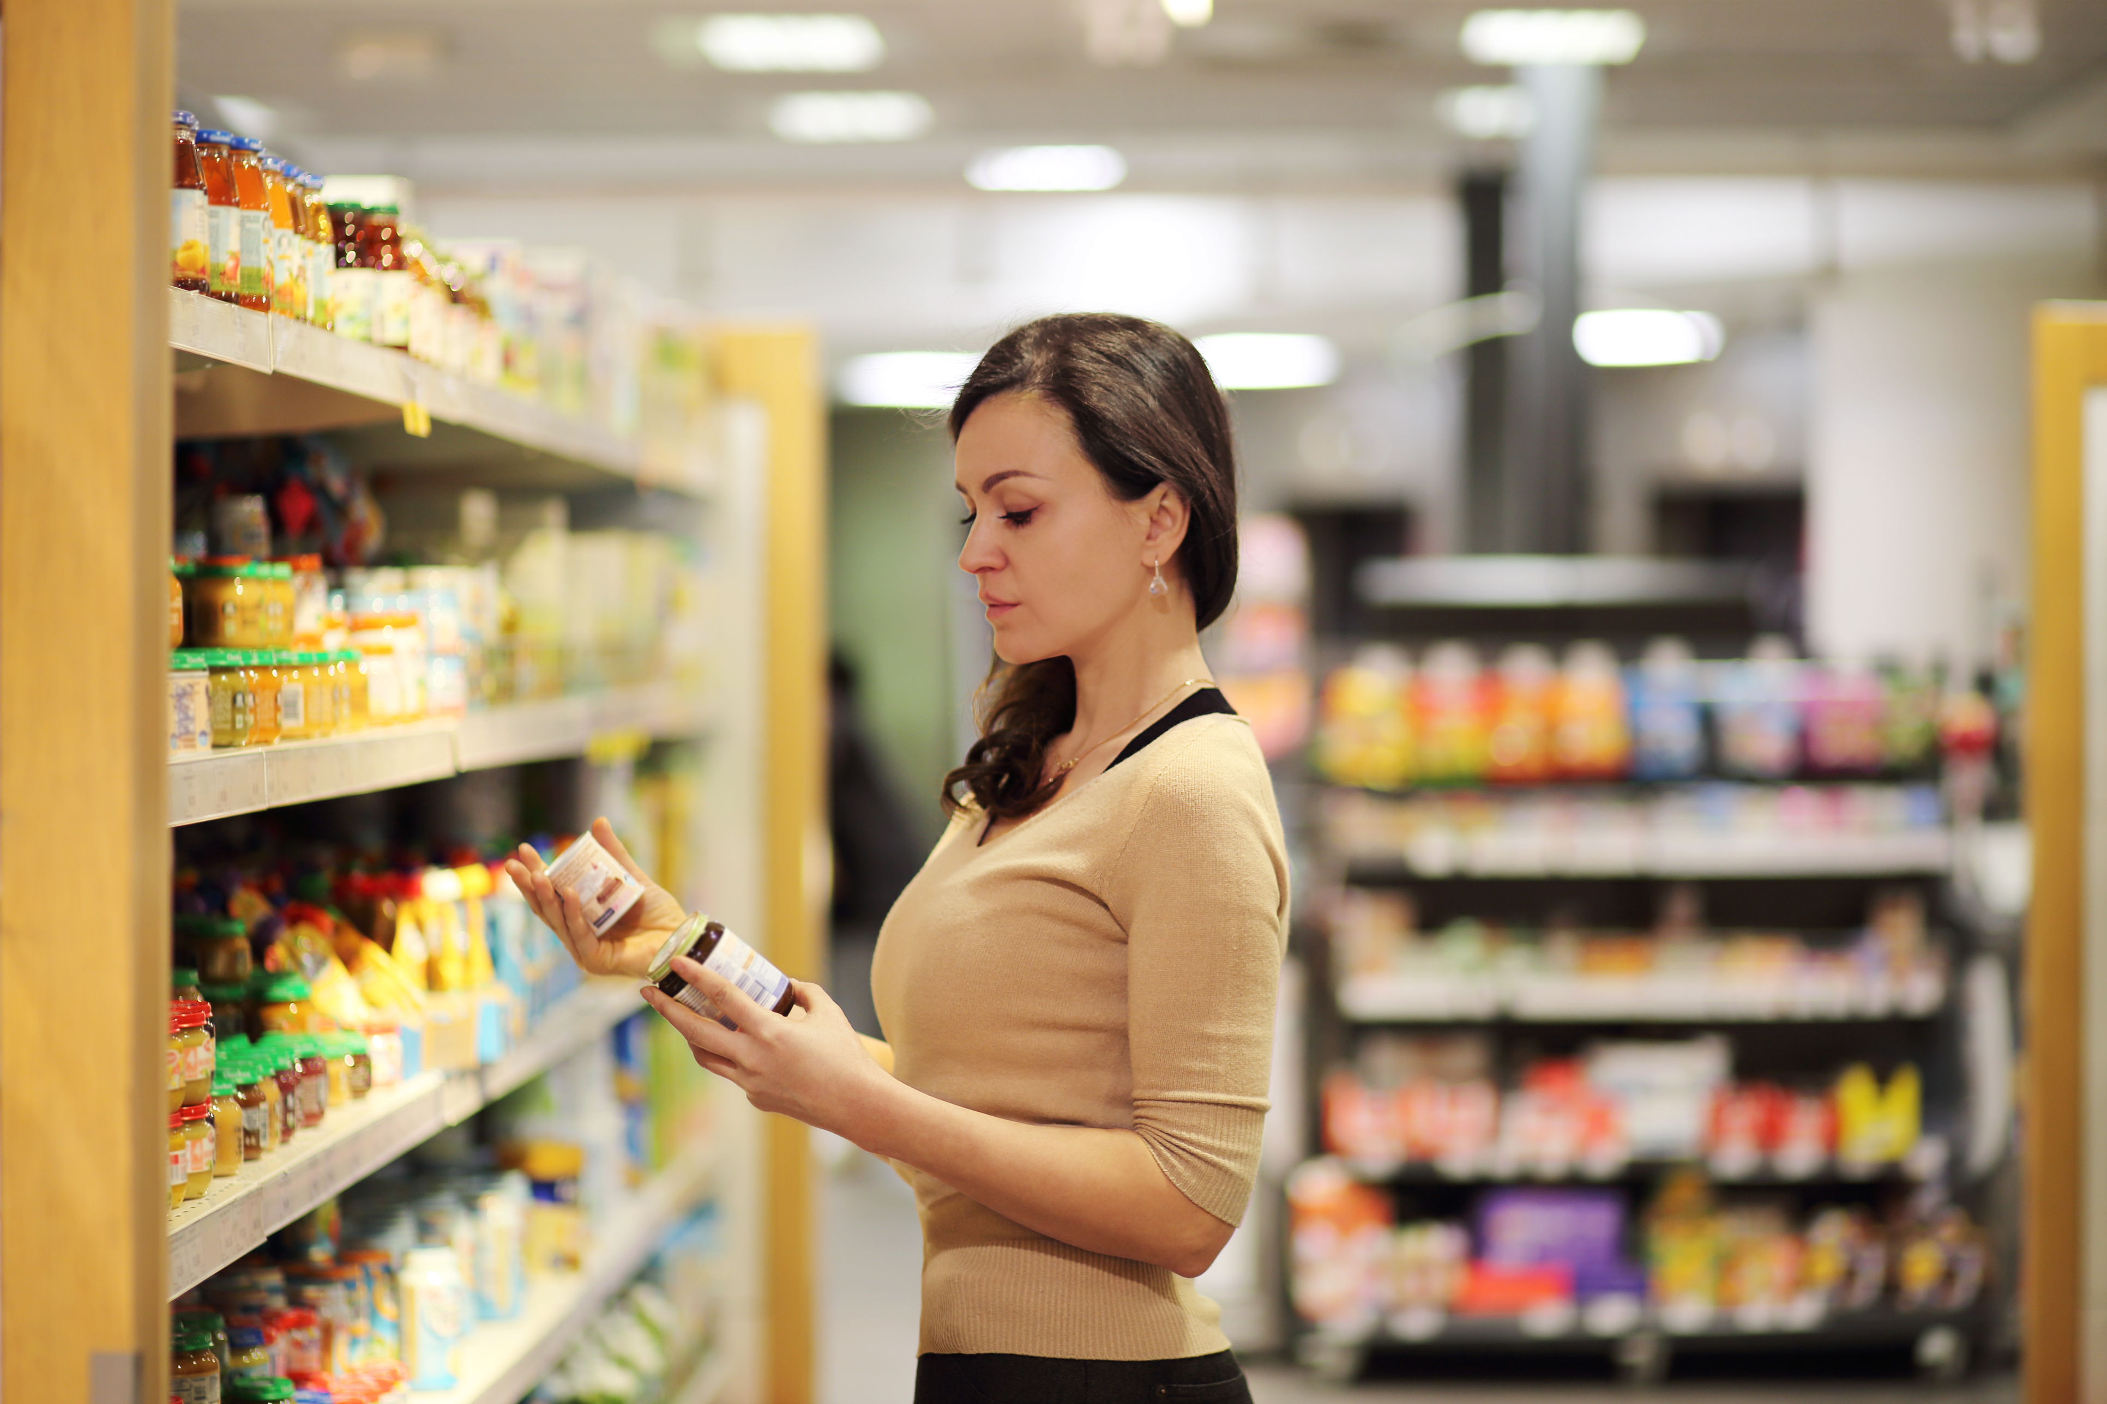
75%
In Thailand
50%
73%
In India
64%
In Saudi Arabia
agree that the rising cost of living is impacting their health and well-being
63%
In Singapore and UAE
“The rising cost of living is impacting my health and well-being.”
43%
Europe (46% UK)

Slide 44

COST OF LIVING
Due to the current climate, people are feeling more stressed
34%
I feel more stressed (+1pp since last wave)
21%
I’m buying fewer items to support my health
(+1pp since last wave)
UK: 34% (-4pp since last wave)
UK: 12% (-3pp since last wave)
20%
I’m eating less healthy
(+1pp since last wave)
18%
I’m getting less exercise
(-1pp since last wave)
UK: 19% (-1pp since last wave)
UK: 14% (-1pp since last wave)
16%
I’m less health conscious because I have other priorities
(no change since last wave)
UK: 14% (+1pp since last wave)

Slide 45
The top areas consumers expect to spend more in the next three months are:
Areas consumers will spend more:
[Top 2 Box – Spend a lot more/ a bit more]
[Bottom 2 Box – Spend a lot less/ a bit less]
UK
12%
13%
16%
11%
10%
11%
UK
18%
21%
29%
14%
12%
23%
Healthcare
Supplements & items to support my health
Personal care & hygiene products

Slide 46

Brand values, ethics, and social responsibility
- GLOBAL BAROMETER: Wave 21

Slide 47
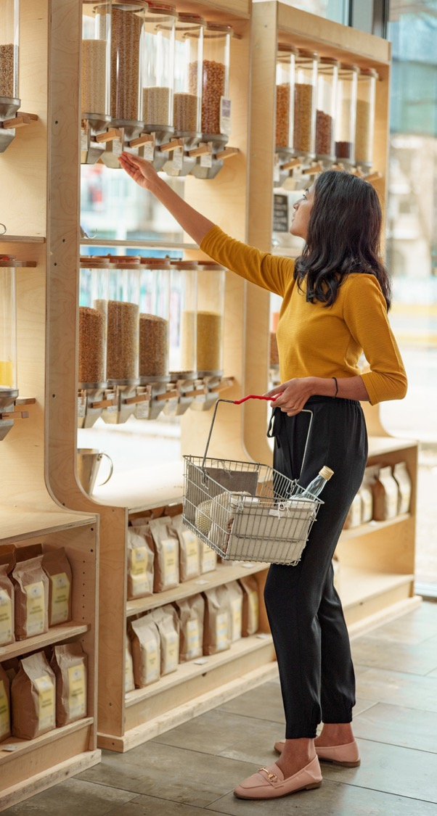
Brand values
Positive environmental and social activities remain highly important in determining whether consumers will use a brand (70%)
    Nearly 7 in 10 (67%) global consumers would stop using a brand because of its negative environmental and social activities
    However, a significant number of consumers don’t have enough information about it to start making those changes (66%).
Consumers are thinking more about the values of the brands they buy.
8 in 10
global consumers believe that brands should be accountable to consumers.
64%
go out of their way to engage with brands that align with their values
3 in 4
agree that it is important to invest time and care into the decisions they make as a consumer
- GLOBAL BAROMETER: Wave 21

Slide 48
BRAND VALUES
Shoppers still care about brand accountability and brand values
76%
Of global consumers feel satisfied when they make socially responsible choices
68%
Of global consumers like to be informed about the values/ethics of the brands they use
64%
go out of their way to engage with brands that align with their values. The same proportion avoid brands whose values aren’t aligned with theirs
Notes:
Wave 18 - 79% accountable / 61% align with their values

Slide 49
70%
would like to make more decisions about which brands they use based on environmental and social factors, but don’t have enough information
of global consumers would start using a brand—or use it more—because of its positive environmental and social activities
would like to make more decisions about which brands they use based on environmental and social factors, but can’t afford to

Slide 50

BRAND VALUES
67%
would stop using a brand because of its negative environmental and social activities

Slide 51

BRAND VALUES
76%
of people would like their savings and investments to align with their values
66%
Would never invest in a product if it was detrimental to sustainability

Slide 52
BRAND VALUES
The THREE most important actions for brands to take:
66%
Brands being sincere and authentic in what they do
58%
Brands being committed to reducing the use of plastic/ paper/ packaging
55%
Brands having policies which benefit the environment and society

Slide 53

In summary….

Slide 54
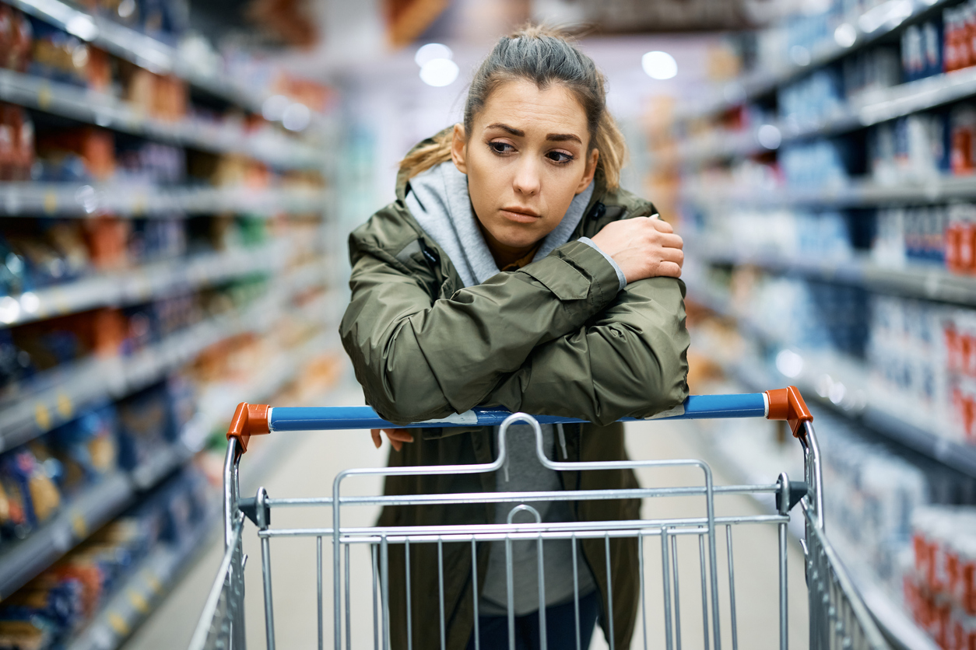


Key Global Themes from Today….
Despite low consumer confidence, there are signs of optimism that things will improve by the end of 2023. For now, shoppers will continue to adapt behaviors & plan for financial challenges in the short term.
The cost-of-living crisis dramatically impacted people’s outlook on saving, spending, and credit over the holiday season. Its associated debt is now a concern for 1 in 4.
Health & well-being continue to be negatively impacted by financial & social challenges.

Slide 55
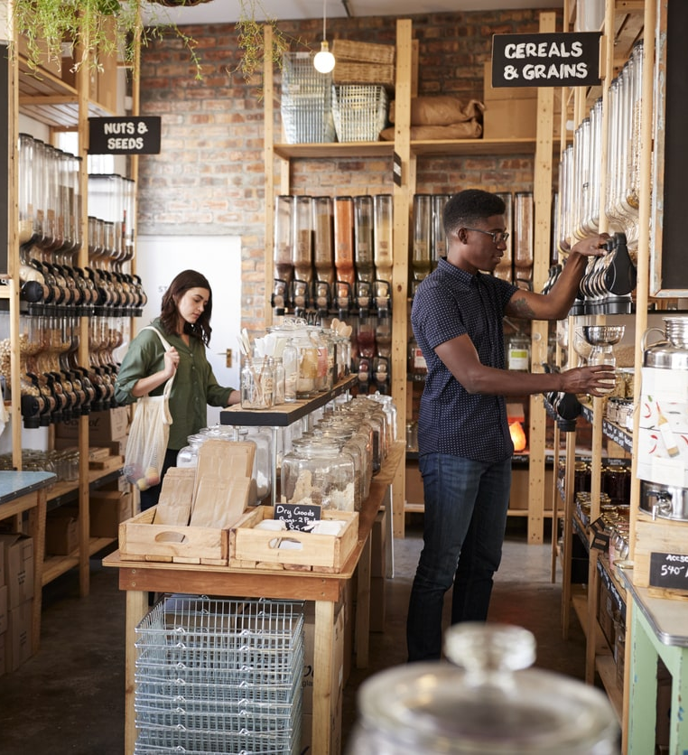
Wave 21 Global Barometer
Cost of living: Testing the resilience of the global consumer in 2023
Thank you!

